Slide 1
CSC6032 – Advanced Operating Systems
Prof. Yeh-Ching Chung
School of Data Science
Chinese University of Hong Kong, Shenzhen

Slide 2
虛擬化技術 Virtualization Techniques
GPU Virtualization

Slide 3
Agenda
Introduction GPGPU
High Performance Computing Clouds
GPU Virtualization with Hardware Support
References

Slide 4
Introduction GPGPU

Slide 5
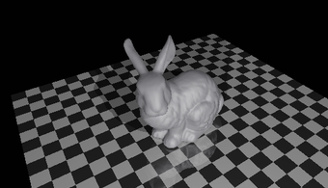
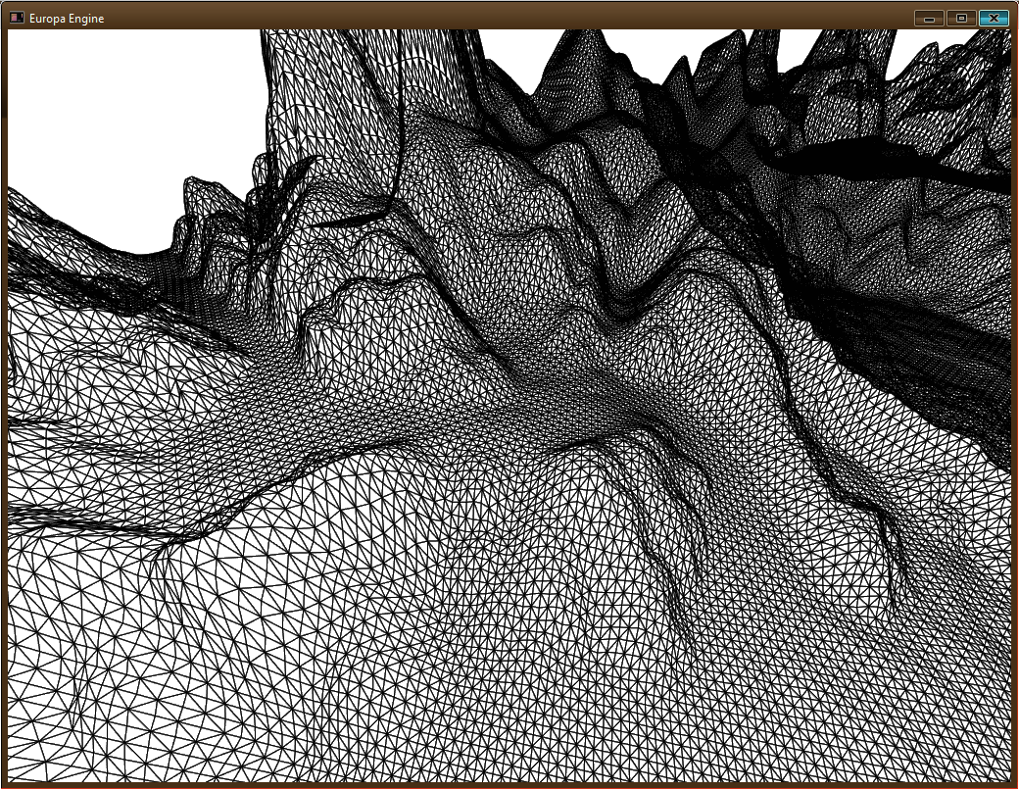
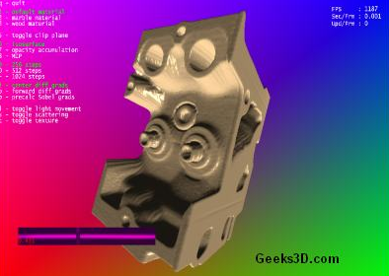
GPU
Graphics Processing Unit (GPU)
Driven by the market demand for real-time and high-definition 3D graphics, the programmable Graphic Processor Unit (GPU) has evolved into a highly parallel, multithreaded, many core processor with tremendous computational power and very high memory bandwidth

Slide 6
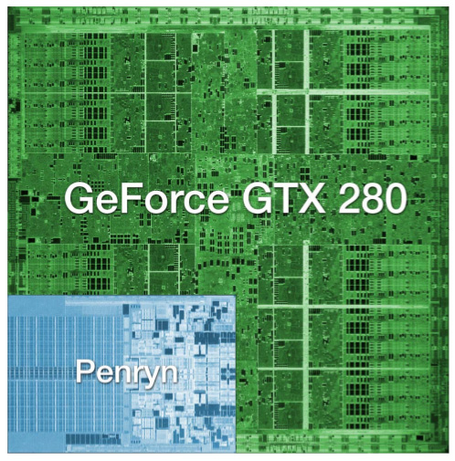
How much computation?
NVIDIA GeForce GTX 280:
1.4 billion transistors
Intel Core 2 Duo:
291 million transistors
Source: AnandTech review of NVidia GT200
Notes:
-Modern GPUs have more transistors, draw more power, and offer at least an order of magnitude more compute power than CPUs
-That’s a lot of wasted computation potential in virt solutions which don’t support the GPU.

Slide 7
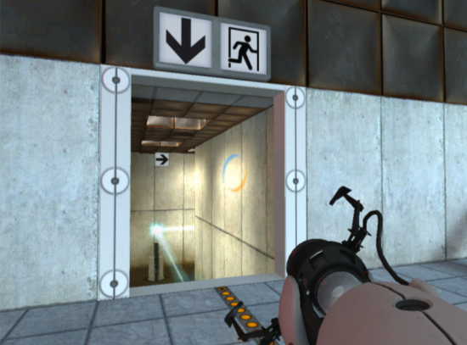
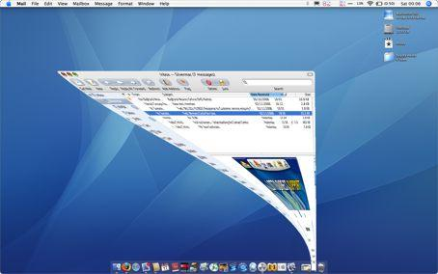
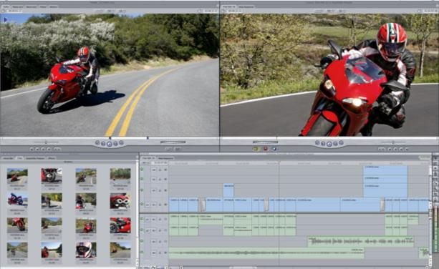
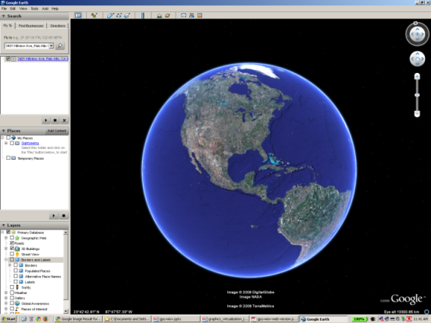
What are GPUs good for?
Desktop Apps
Entertainment
CAD
Multimedia
Productivity
Desktop GUIs
Quartz Extreme
Vista Aero
Compiz
Notes:
-GPU technology is largely being driven by games
-But they’re also used by CAD apps, productivity apps like Google Earth, video processing
-And now, Windows, Mac OS, and Linux all have a user interface which supports GPU acceleration

Slide 8
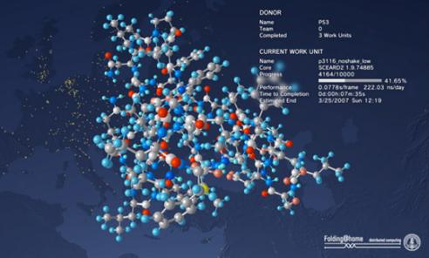
GPUs in the Data Center
Server-hosted Desktops
GPGPU
Notes:
-GPUs are currently most important on the desktop
- The use cases are consumer apps (Windows games on Mac), professional apps, and GPU-accelerated windowing systems
- This means that the most immediate need is for a hosted solution: coexists with the user’s existing OS
-But GPUs in the data center are also expected to emerge as an important solution space
- GPGPU apps (scientific, financial)
- Server-hosted virtual desktops

Slide 9
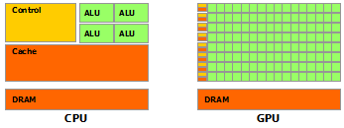
CPU vs. GPU
The reason behind the discrepancy between the CPU and the GPU is
The GPU is specialized for compute-intensive, highly parallel computation.
The GPU is designed for data processing rather than data caching and flow control

Slide 10
CPU vs. GPU
GPU is especially well-suited for data-parallel computations
The same program is executed on many data elements in parallel
Lower requirement for sophisticated flow control
Execute on many data elements and is arithmetic intensity
The memory access latency can be overlapped with calculations instead of big data caches

Slide 11
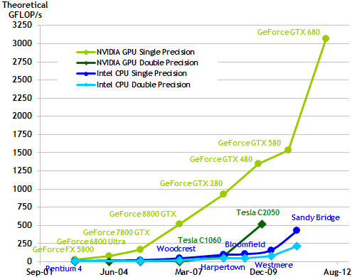
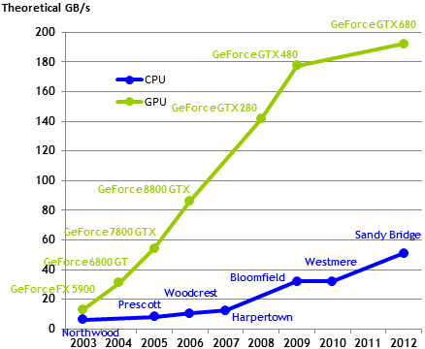
CPU vs. GPU
Memory Bandwidth
Floating-Point Operations per Second

Slide 12
GPGPU
The general-purpose graphic processing unit (GPGPU) is the utilization of GPUs to perform computations that are traditionally handled by the CPUs
GPU with a complete set of operations performed on arbitrary bits can compute any computable value

Slide 13
GPGPU Computing Scenarios
Low-level of data parallelism
No GPU is needed, just proceed with the traditional HPC strategies
High-level of data parallelism
Add one or more GPUs to every node in the system and rewrite applications to use them
Moderate-level of data parallelism
The GPUs in the system are used only for some parts of the application,
Remain idle the rest of the time and, thus waste resources and energy
Applications for multi-GPU computing
The code running in a node can only access the GPUs in that node, but it would run faster if it could have access to more GPUs

Slide 14
NVIDIA GPGPUs
Features | Tesla K20X | Tesla K20 | Tesla K10 | Tesla M2090 | Tesla M2075
Number and Type of GPU | 1 Kepler GK110 |  | 2 Kepler GK104s | 1 Fermi GPU | 1 Fermi GPU
GPU Computing Applications | Seismic processing, CFD, CAE, Financial computing, Computational chemistry and Physics, Data analytics, Satellite imaging, Weather modeling |  | Seismic processing, signal and image processing, video analytics | Seismic processing, CFD, CAE, Financial computing, Computational chemistry and Physics, Data analytics, Satellite imaging, Weather modeling
Peak double precision floating point performance | 1.31 Tflops | 1.17 Tflops | 190 Gigaflops (95 Gflops per GPU) | 665 Gigaflops | 515 Gigaflops
Peak single precision floating point performance | 3.95 Tflops | 3.52 Tflops | 4577 Gigaflops (2288 Gflops per GPU) | 1331 Gigaflops | 1030 Gigaflops
Memory bandwidth (ECC off) | 250 GB/sec | 208 GB/sec | 320 GB/sec (160 GB/sec per GPU) | 177 GB/sec | 150 GB/sec
Memory size (GDDR5) | 6 GB | 5 GB | 8GB (4 GB per GPU) | 6 GigaBytes | 6 GigaBytes
CUDA cores | 2688 | 2496 | 3072 (1536 per GPU) | 512 | 448

Slide 15
NVIDIA K20 Series
NVIDIA Tesla K-series GPU Accelerators are based on the NVIDIA Kepler compute architecture that includes
SMX (streaming multiprocessor) design that delivers up to 3x more performance per watt compared to the SM in Fermi
Dynamic Parallelism capability that enables GPU threads to automatically spawn new threads
Hyper-Q feature that enables multiple CPU cores to simultaneously utilize the CUDA cores on a single Kepler GPU

Slide 16
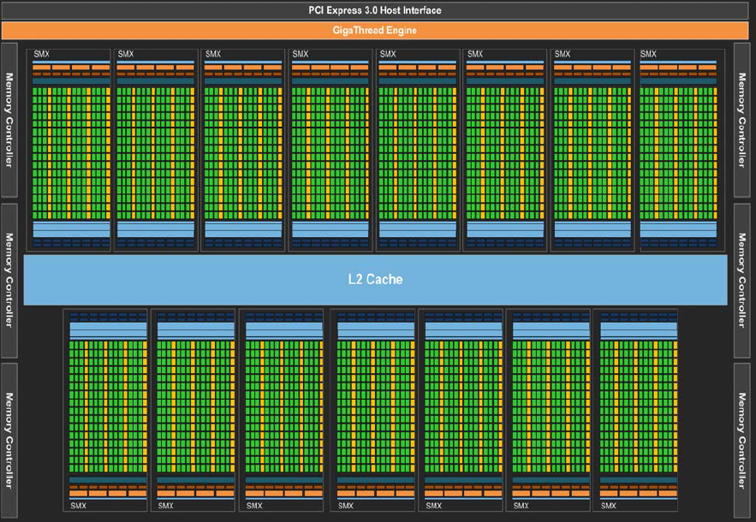
NVIDIA K20
NVIDIA Tesla K20 (GK110) Block Diagram

Slide 17
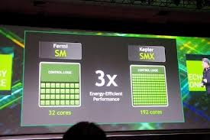
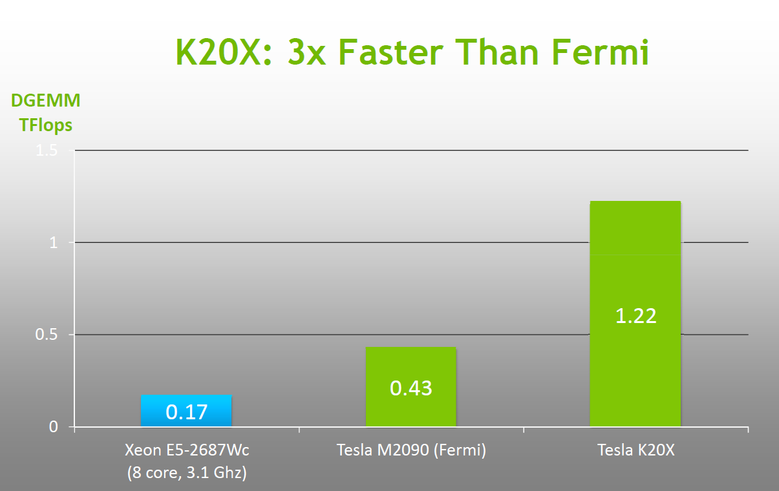
NVIDIA K20 Series
SMX (streaming multiprocessor) design that delivers up to 3x more performance per watt compared to the SM in Fermi

Slide 18
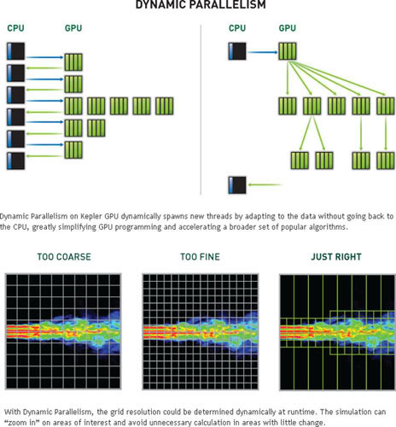
NVIDIA K20 Series
Dynamic Parallelism

Slide 19
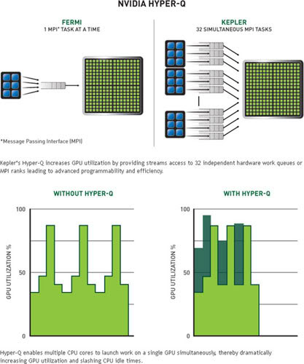
NVIDIA K20 Series
Hyper-Q Feature

Slide 20

GPGPU TOOLS
Two main approaches in GPGPU computing development environments
CUDA
NVIDIA proprietary
OpenCL
Open standard

Slide 21
High Performance Computing clouds

Slide 22
Top 10 Supercomputers (Nov. 2012)
Rank | Site | System | Cores | Rmax (TFlop/s) | Rpeak (TFlop/s) | Power (kW)
1 | DOE/SC/Oak Ridge National Laboratory United States | Titan - Cray XK7 , Opteron 6274 16C 2.200GHz, Cray Gemini interconnect, NVIDIA K20x Cray Inc. | 560640 | 17590.0 | 27112.5 | 8209
2 | DOE/NNSA/LLNL United States | Sequoia - BlueGene/Q, Power BQC 16C 1.60 GHz, Custom IBM | 1572864 | 16324.8 | 20132.7 | 7890
3 | RIKEN Advanced Institute for Computational Science (AICS) Japan | K computer, SPARC64 VIIIfx 2.0GHz, Tofu interconnect Fujitsu | 705024 | 10510.0 | 11280.4 | 12660
4 | DOE/SC/Argonne National Laboratory United States | Mira - BlueGene/Q, Power BQC 16C 1.60GHz, Custom IBM | 786432 | 8162.4 | 10066.3 | 3945
5 | Forschungszentrum Juelich (FZJ) Germany | JUQUEEN - BlueGene/Q, Power BQC 16C 1.600GHz, Custom Interconnect IBM | 393216 | 4141.2 | 5033.2 | 1970
6 | Leibniz Rechenzentrum Germany | SuperMUC - iDataPlex DX360M4, Xeon E5-2680 8C 2.70GHz, Infiniband FDR IBM | 147456 | 2897.0 | 3185.1 | 3423
7 | Texas Advanced Computing Center/Univ. of Texas United States | Stampede - PowerEdge C8220, Xeon E5-2680 8C 2.700GHz, Infiniband FDR, NVIDIA K20, Intel Xeon Phi, Dell | 204900 | 2660.3 | 3959.0
8 | National Supercomputing Center in Tianjin China | Tianhe-1A - NUDT YH MPP, Xeon X5670 6C 2.93 GHz, NVIDIA 2050 NUDT | 186368 | 2566.0 | 4701.0 | 4040
9 | CINECA Italy | Fermi - BlueGene/Q, Power BQC 16C 1.60GHz, Custom IBM | 163840 | 1725.5 | 2097.2 | 822
10 | IBM Development Engineering United States | DARPA Trial Subset - Power 775, POWER7 8C 3.836GHz, Custom Interconnect IBM | 63360 | 1515.0 | 1944.4 | 3576

Slide 23
High Performance Computing Clouds
Fast interconnects
Hundreds of nodes, with multiple cores per node
Hardware accelerators
better performance-watt, performance-cost ratios for certain applications
How to achieve the High Performance Computing?
App
App
App
GPU array
App
App
App
App
App
App
App
App

Slide 24
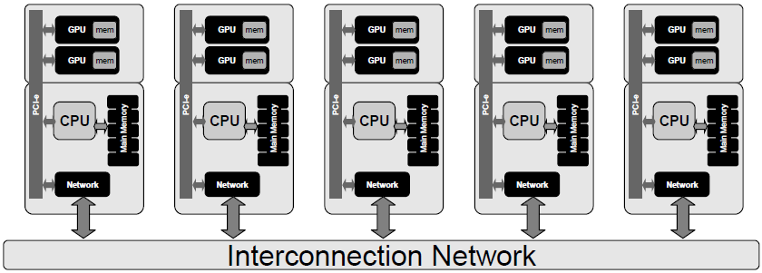
High Performance Computing Clouds
Add GPUs at each node
Some GPUs may be idle for long periods of time
A waste of money and energy

Slide 25
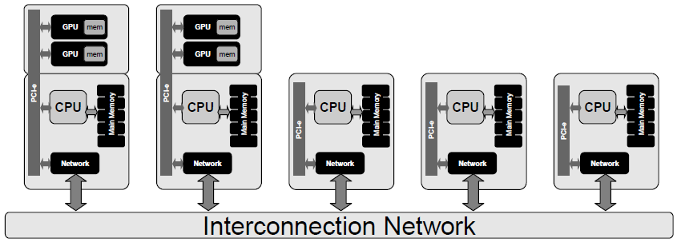
High Performance Computing Clouds
Add GPUs at some nodes
Lack flexibility

Slide 26
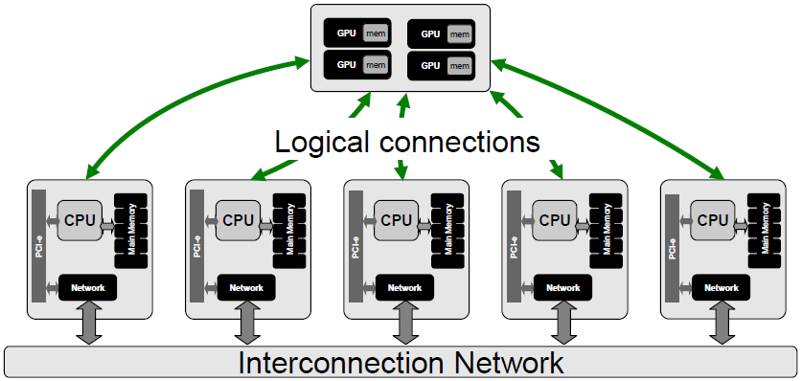
High Performance Computing Clouds
Add GPUs at some nodes and make them accessible from every node (GPU virtualization)
How to achieve it?

Slide 27
GPU Virtualization Overview
GPU device is under control of the hypervisor
GPU access is routed via the front-end/back-end
The management component controls invocation and data movement
VM
VM
VM
vGPU
vGPU
vGPU
VM
VM
VM
front-end
front-end
front-end
vGPU
vGPU
vGPU
front-end
front-end
front-end
Hypervisor
Hypervisor
Host OS
back-end
back-end
Device(GPU)
Device(GPU)
※Hypervisor independent

Slide 28
Interface Layers Design
Normal GPU Component Stack
Split the stack into hardware and software binding
User Application
User Application
GPU Driver API
GPU Driver
GPU Enabled Device
GPU Driver API
soft binding
direct communication
We can cheat the application!
GPU Driver
GPU Enabled Device
hard binding

Slide 29
Architecture
Re-group the stack into host and remote side
User Application
vGPU Driver API
remote binding (guest OS)
Front End
Communicator (network)
Back End
GPU Driver API
host binding
GPU Driver
GPU Enabled Device

Slide 30
Key Component
vGPU Driver API
A fake API as adapter to adapt the instant driver and the virtual driver
Run on guest OS kernel mode
Front End
API interception
parameters passed
order semantics
Pack the library function invocation
Send packs to the back end
Interact with the GPU library (GPU driver ) by terminating the GPU operation
Provide results to the calling program
User Application
vGPU Driver API
Front End
communicator
Back End
GPU Driver API
GPU Driver
GPU Enabled Device

Slide 31
Key Component
Communicator
Provide a high performance communication between VM and host
Back End
Deal with the hardware using the GPU driver
Unpack the library function invocation
Map memory pointers
Execute the GPU operations
Retrieve the results
Send results to the front end using the communicator
User Application
vGPU Driver API
Front End
communicator
Back End
GPU Driver API
GPU Driver
GPU Enabled Device

Slide 32
Communicator
The choice of the hypervisor deeply affects the efficiency of the communication
Communication may be a bottleneck
Platform | Communicator | Note
Generic | Unix Sockets, TCP/IP, RPC | Hypervisor independent
Xen | XenLoop | Provide a communication library between guest and host machines Implement low latency and wide bandwidth TCP/IP and UDP connections Application transparent and offers an automatic discovery of the supported VMS
VMware | VM Communication Interface (VMCI) | Provide a datagram API to exchange small messages A shared memory API to share data, an access control API to control which resources a virtual machine can access A discovery service for publishing and retrieving resources.
KVM/QEMU | VMchannel | Linux kernel module now embedded as a standard component Provide a high performance guest/host communication Based on a shared memory approach.

Slide 33
Lazy Communication
Reduce the overhead of switching between host OS and guest OS
Instant API: whose executions have immediate effects on the state of GPU hardware, ex: GPU memory allocation
Non-instant API: which are side-effect free on the runtime state, ex: setup GPU arguments
User Application
vGPU Driver API
Front End (API interception)
Instant API call
communication
Back End
GPU Driver API
NonInstant API call
GPU Driver
GPU Enabled Device
NonInstant API Buffer

Slide 34
Walkthrough
A fake API as adapter to adapt the instant driver and the virtual driver
guest
host
User Application
Back End
vGPU Driver API
GPU Driver API
Front End
GPU Driver
GPU Enabled Device
communicator

Slide 35
Walkthrough
guest
host
User Application
Back End
API interception
Pack the library function invocation
Sends packs to the back end
vGPU Driver API
GPU Driver API
Front End
GPU Driver
GPU Enabled Device
communicator

Slide 36
Walkthrough
Deal with the hardware using the GPU driver
Unpack the library function invocation
guest
host
User Application
Back End
vGPU Driver API
GPU Driver API
Front End
GPU Driver
GPU Enabled Device
communicator

Slide 37
Walkthrough
Map memory pointers
Execute the GPU operations
guest
host
User Application
Back End
vGPU Driver API
GPU Driver API
Front End
GPU Driver
GPU Enabled Device
communicator

Slide 38
Walkthrough
Retrieve the results
Send results to the front end using the communicator
guest
host
User Application
Back End
vGPU Driver API
GPU Driver API
Front End
GPU Driver
GPU Enabled Device
communicator

Slide 39
Walkthrough
Interact with the GPU library (GPU driver ) by terminating the GPU operation
Provide results to the calling program
guest
host
User Application
Back End
vGPU Driver API
GPU Driver API
Front End
GPU Driver
GPU Enabled Device
communicator

Slide 40
GPU Virtualization Taxonomy
API Remoting
Device Emulation
Front-end
Hybrid
(Driver VM)
Back-end
Fixed Pass-through
1:1
Mediated Pass-through
1:N

Slide 41
GPU Virtualization Taxonomy
Major distinction is based on where we cut the driver stack
Front-end: Hardware-specific drivers are in the VM
Good portability, mediocre speed
Back-end: Hardware-specific drivers are in the host or hypervisor
Bad portability, good speed
Back-end: Fixed vs. Mediated
Fixed: one device, one VM. Easy with an IOMMU
Mediated: Hardware-assisted multiplexing, to share one device with multiple VMs
Requires modified GPU hardware/drivers (Vendor support)
Front-end
API remoting: replace API in VM with a forwarding layer. Marshall each call, execute on host
Device emulation: Exact emulation of a physical GPU
There are also hybrid approaches: For example, a driver VM using fixed pass-through plus API remoting

Slide 42





API Remoting
Time-sharing real device
Client-server architecture
Analogous to full paravirtualization of a TCP offload engine
Hardware varied by vendors, it is not necessary for VM-developer to implements hardware drivers for them

Slide 43
API Remoting
Guest
Host
App
App
App
RPC Endpoint
User-level
API
OpenGL / Direct3D Redirector
OpenGL / Direct3D
API
GPU Driver
Kernel
GPU
Hardware
Notes:
The simplest approach... (one extreme)
Analogous to full paravirtualization of a TCP offload engine.
Easy, but you get what you pay for.
Pro:
Easy to get working
easy to support new APIs/features
Con:
Hard to make performant (Where do objects live? When to cross RPC boundary? Caches? Batching?)
VM Goodness (checkpointing, portability) is really hard
Who’s using it?
Parallels’ initial GL implementation
Remote rendering: GLX, Chromium project
Open source “VMGL”: OpenGL on VMware and Xen
http://www.cs.toronto.edu/~andreslc/xen-gl/

Slide 44
API Remoting
Pro
Easy to get working
Easy to support new APIs/features
Con
Hard to make performant (Where do objects live? When to cross RPC boundary? Caches? Batching?)
VM Goodness (checkpointing, portability) is really hard
Who’s using it?
Parallels’ initial GL implementation
Remote rendering: GLX, Chromium project
Open source “VMGL”: OpenGL on VMware and Xen

Slide 45

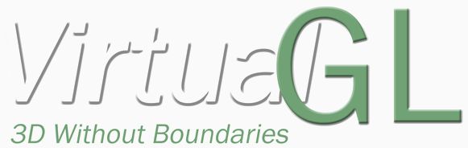
Related work
These are downloadable and can be used
rCUDA
http://www.rcuda.net/
vCUDA
http://hgpu.org/?p=8070
gVirtuS
http://osl.uniparthenope.it/projects/gvirtus/
VirtualGL
http://www.virtualgl.org/

Slide 46
Other Issues
The concept of “API Remoting” is simple, but implementation is cumbersome.
Engineers have to maintain all APIs to be emulated, but API spec may change in the future.
There are many different APIs related to GPU. Example: OpenGL, DirectX, CUDA, OpenCL…
VMware View 5.2 vSGA support DirectX
rCUDA support CUDA
VirtualGL support OpenGL

Slide 47
Device Emulation
Fully virtualize an existing physical GPU
Like API remoting, but Back-end have to maintain GPU resources and GPU state
Guest
Host
GPU Emulator
Resource Management
User-level
App
App
App
Shader / State Translator
Rendering Backend
API
OpenGL / Direct3D
OpenGL / Direct3D
API
Kernel
Virtual GPU Driver
GPU Driver
Kernel
Virtual HW
Virtual GPU
GPU
Hardware
Shared System
Memory

Slide 48
Device Emulation
Pro
Easy interposition (debugging, checkpointing, portability)
Thin and idealized interface between guest and host
Great portability
Con
Extremely hard, inefficient
Very hard to emulate a real GPU
Moving target- real GPUs change often
At the mercy of vendor’s driver bugs

Slide 49
Fixed Pass-Through
Use VT-d to virtualize memory
VM accesses GPU MMIO directly
GPU accesses guest memory directly
Example
Citrix XenServer
VMware ESXi
Virtual Machine
OpenGL / Direct3D / Compute
App
App
App
API
GPU Driver
Pass-through GPU
DMA
MMIO
IRQ
PCI
VT-d
Physical GPU

Slide 50
Fixed Pass-Through
Pro
Native speed
Full GPU feature set available
Should be extremely simple
No drivers to write
Con
Need vendor-specific drivers in VM
No VM goodness: No portability, no checkpointing
(Unless you hot-swap the GPU device...)
The big one: One physical GPU per VM
(Can’t even share it with a host OS)

Slide 51
Mediated pass-through
Similar to “self-virtualizing” devices, may or may not require new hardware support
Some GPUs already do something similar to allow multiple unprivileged processes to submit commands directly to the GPU
The hardware GPU interface is divided into two logical pieces
One piece is virtualizable, and parts of it can be mapped directly into each VM.
Rendering, DMA, other high-bandwidth activities
One piece is emulated in VMs, and backed by a system-wide resource manager driver within the VM implementation.
Memory allocation, command channel allocation, etc.
(Low-bandwidth, security/reliability critical)

Slide 52
Mediated pass-through
Virtual Machine
Virtual Machine
OpenGL / Direct3D / Compute
OpenGL / Direct3D / Compute
App
App
App
App
App
App
API
API
GPU Driver
GPU Driver
Pass-through GPU
Pass-through GPU
Emulation
Emulation
GPU Resource Manager
Physical GPU

Slide 53
Mediated pass-through
Pro
Like fixed pass-through, native speed and full GPU feature set
Full GPU sharing
Good for VDI workloads
Relies on GPU vendor hardware/software
Con
Need vendor-specific drivers in VM
Like fixed pass-through, “VM goodness” is hard

Slide 54
GPU virtualization with hardware support

Slide 55
GPU Virtualization with Hardware Support
Single Root I/O Virtualization (SR-IOV)
SR-IOV supports native I/O virtualization in existing single root complex PCI-E topologies.
Multi-root I/O Virtualization (MR-IOV)
MR-IOV supports native IOV in new topologies (e.g., blade servers) by building on SR-IOV to provide multiple root complexes which share a common PCI-E hierarchy

Slide 56
GPU Virtualization with Hardware Support
SR-IOV have two major components
Physical Function(PF) is a PCI-E function of a device, includes the SR-IOV Extended Capability in the PCI-E Configuration space.
Virtual Function(VF) is associated with the PCI-E Physical Function, represents a virtualized instance of a device.
VM
VM
VM
VF driver
VF driver
VF driver
Hypervisor
PF driver
Host OS
Device(GPU)
PF
VF
VF
VF

Slide 57
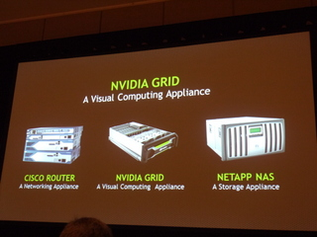
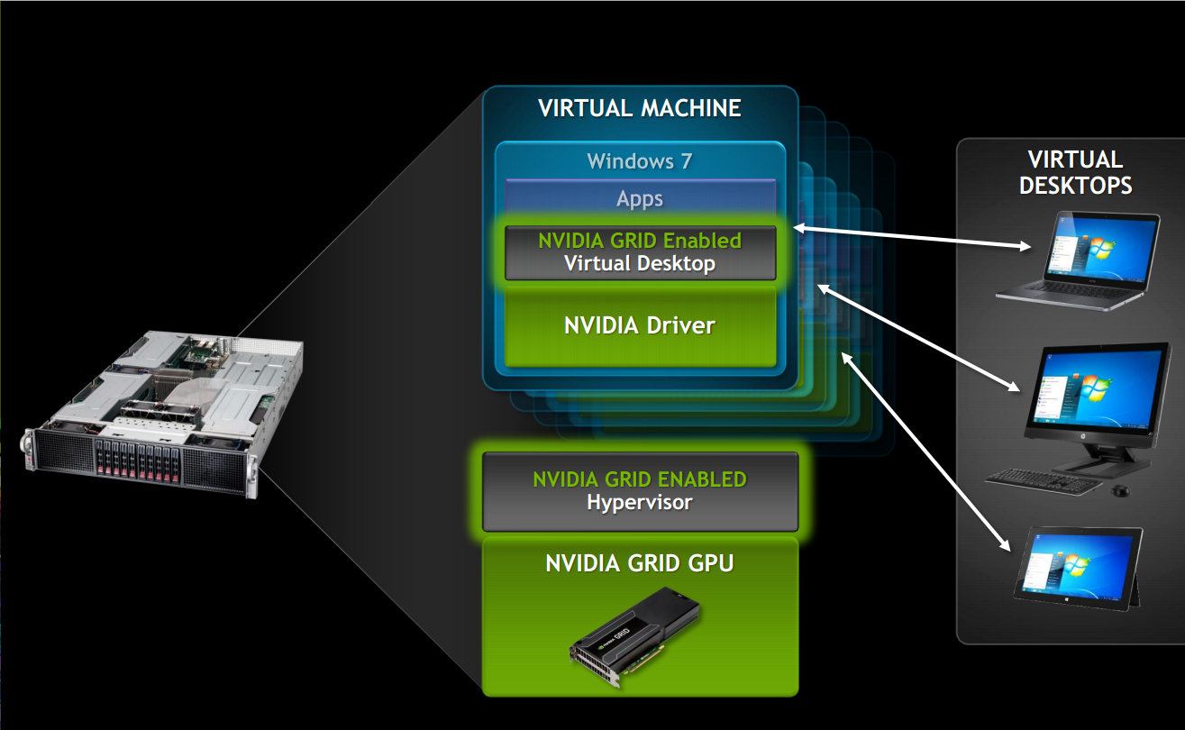
NVIDIA Approach
NVIDIA GRID BOARDS
NVIDIA’s Kepler-based GPUs allow hardware virtualization of the GPU
A key technology is VGX Hypervisor. It allows multiple virtual machines to interact directly with a GPU, manages the GPU resources, and improves user density

Slide 58
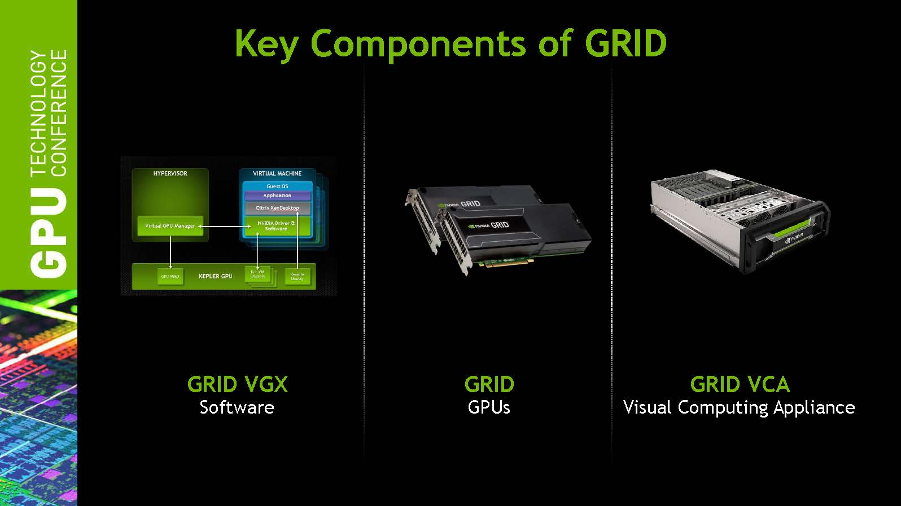
Key Components of GRID

Slide 59
Key Component of Grid
GRID VGX Software

Slide 60
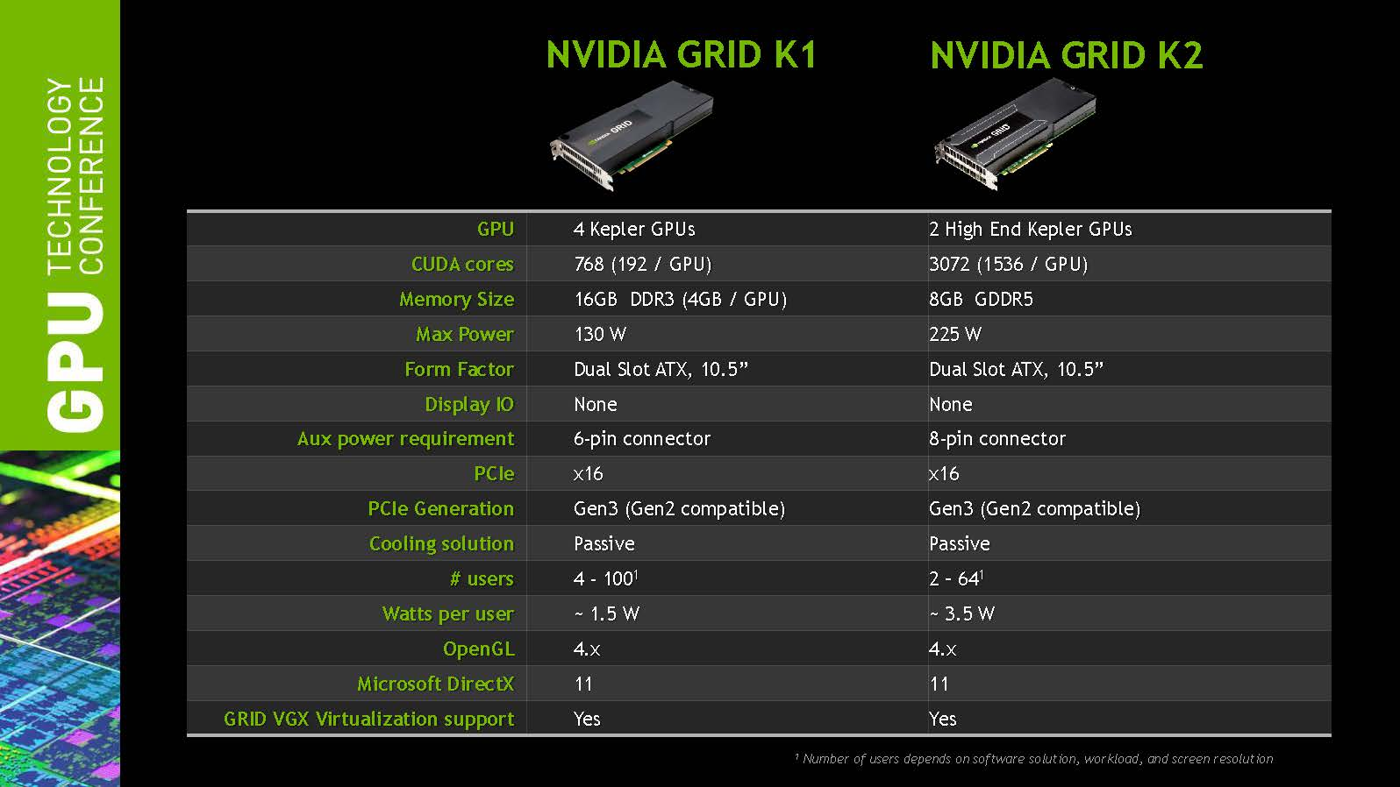
Key Component of Grid
GRID GPUs

Slide 61
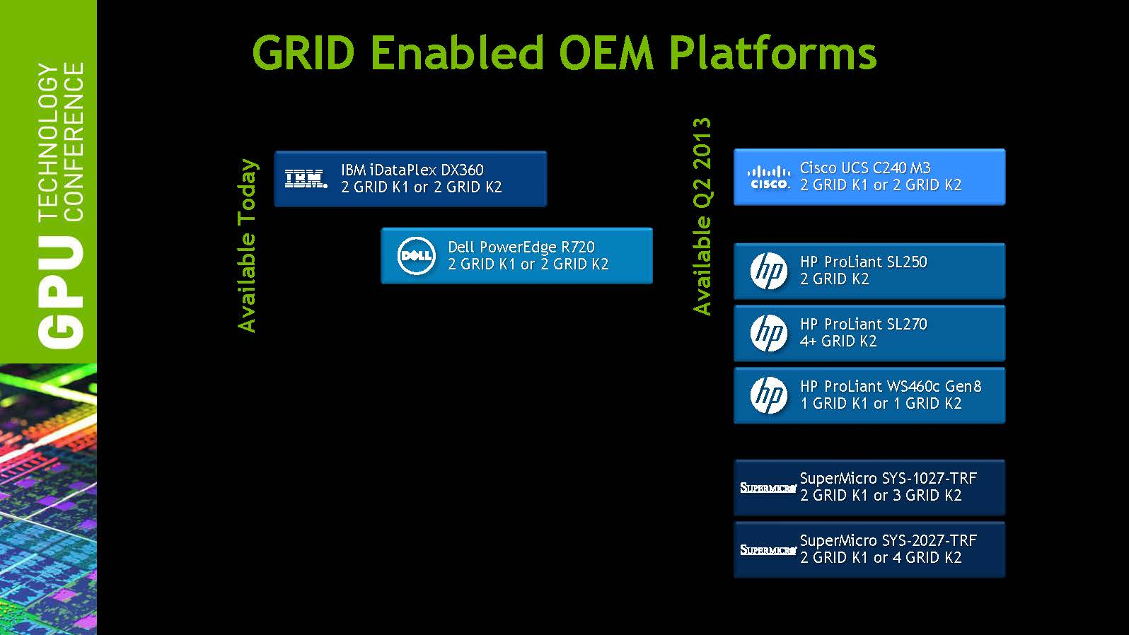
Key Component of Grid
GRID Visual Computing Appliance (VCA)

Slide 62
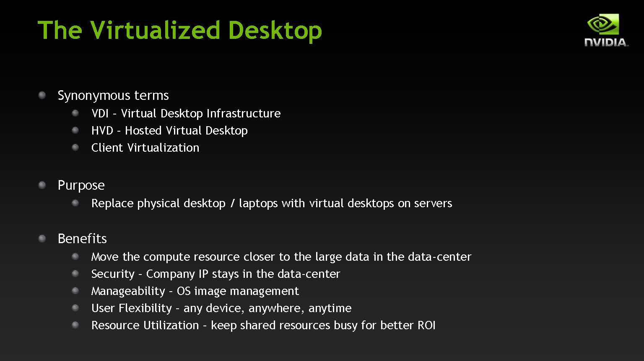
Desktop Virtualization

Slide 63
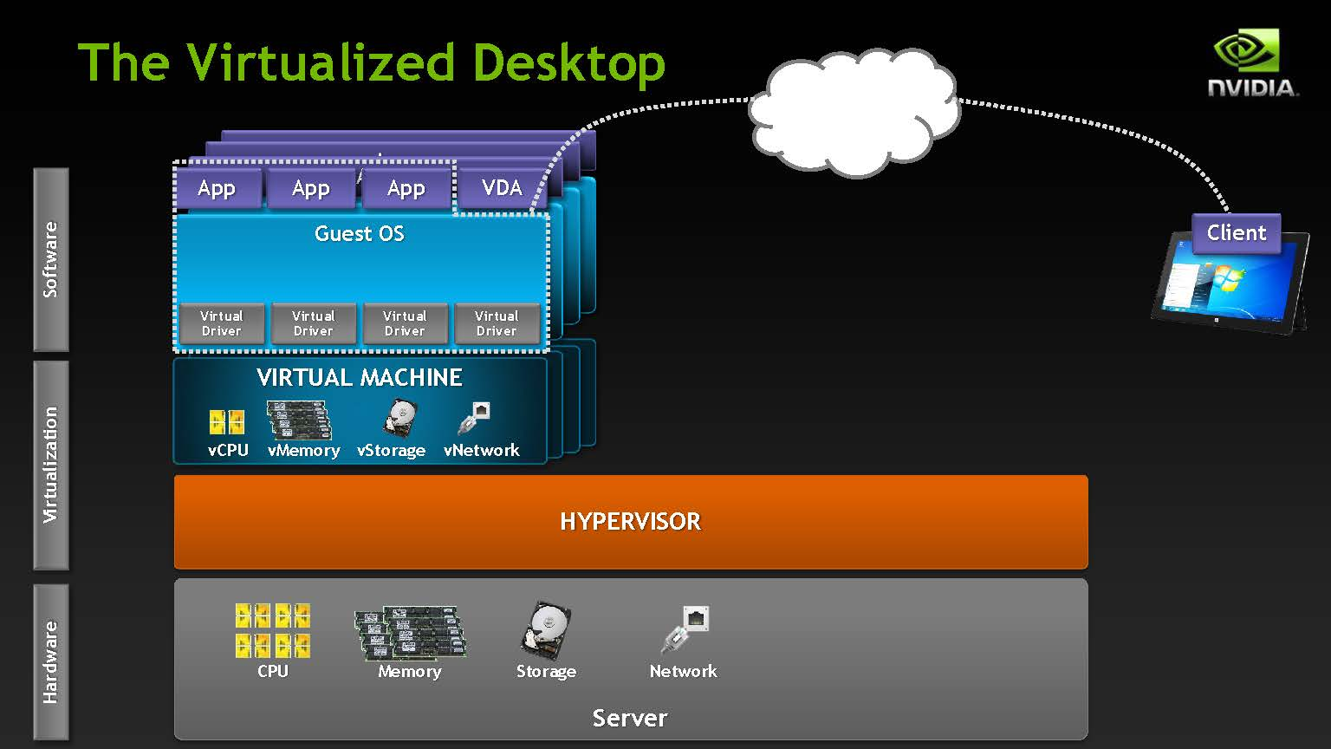
Desktop Virtualization

Slide 64
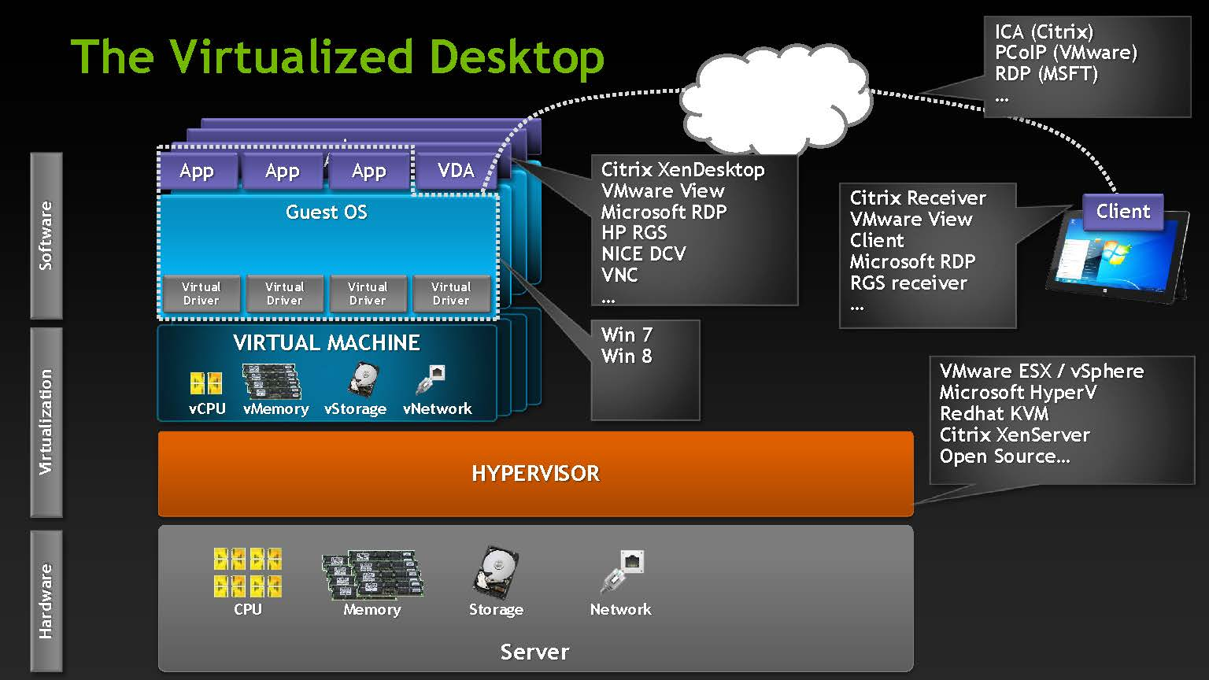
Desktop Virtualization

Slide 65
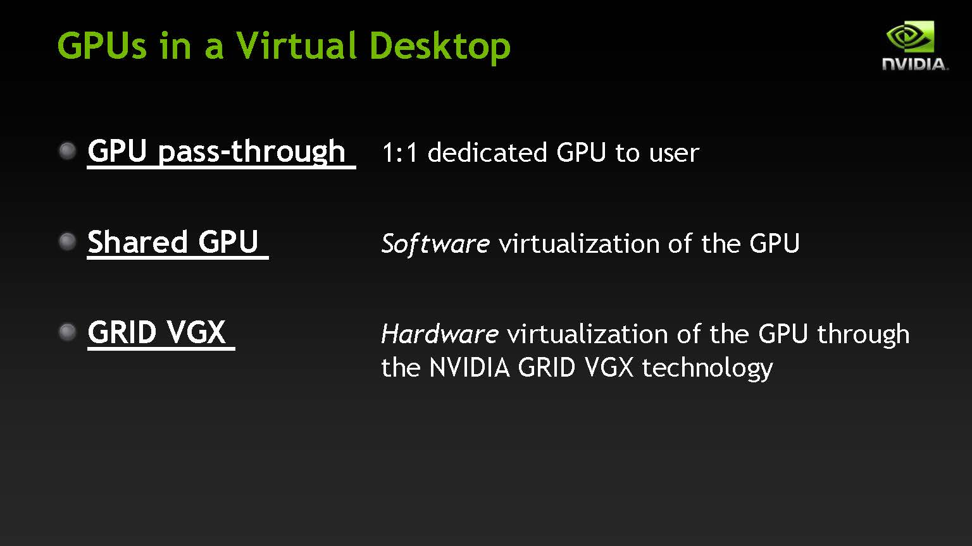
Desktop Virtualization Methods

Slide 66
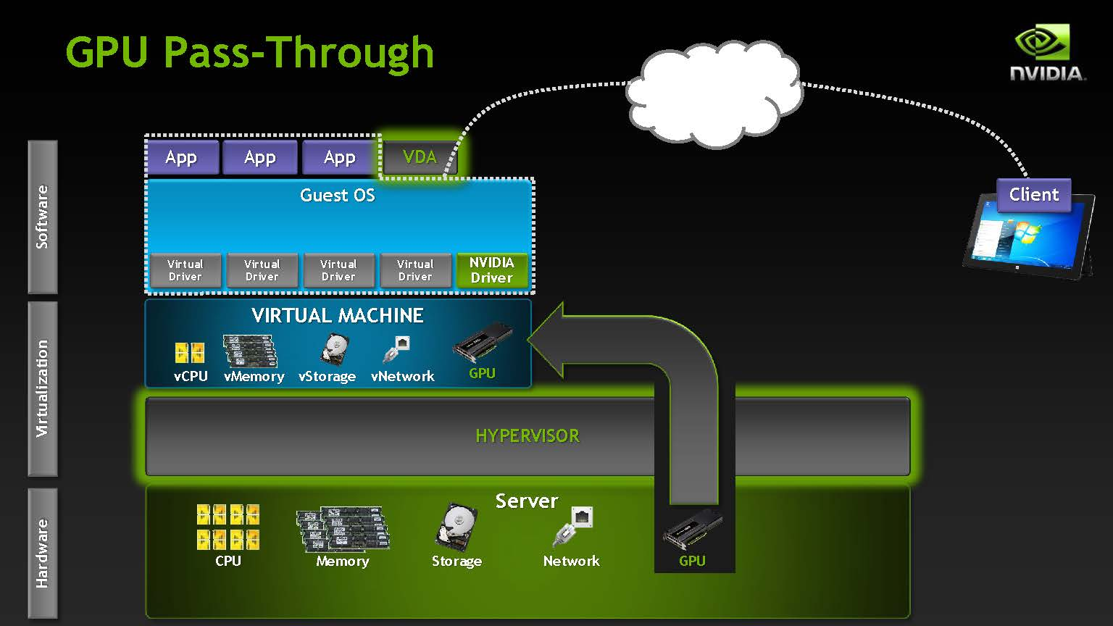
Desktop Virtualization Methods

Slide 67
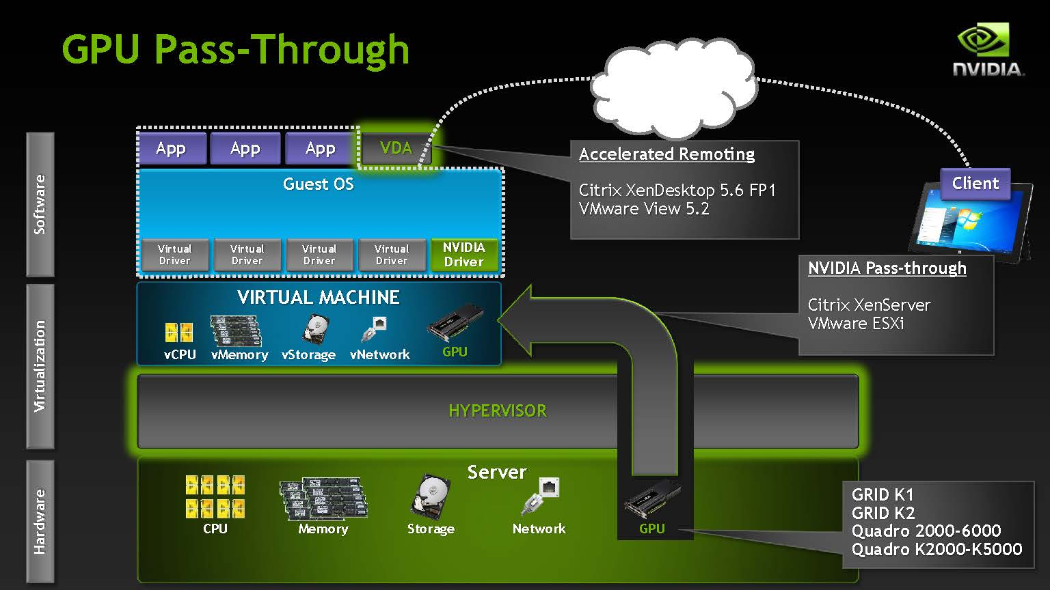
Desktop Virtualization Methods

Slide 68
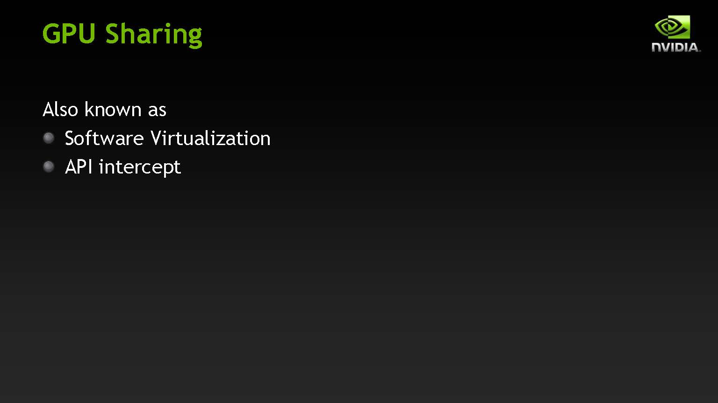
Desktop Virtualization Methods

Slide 69
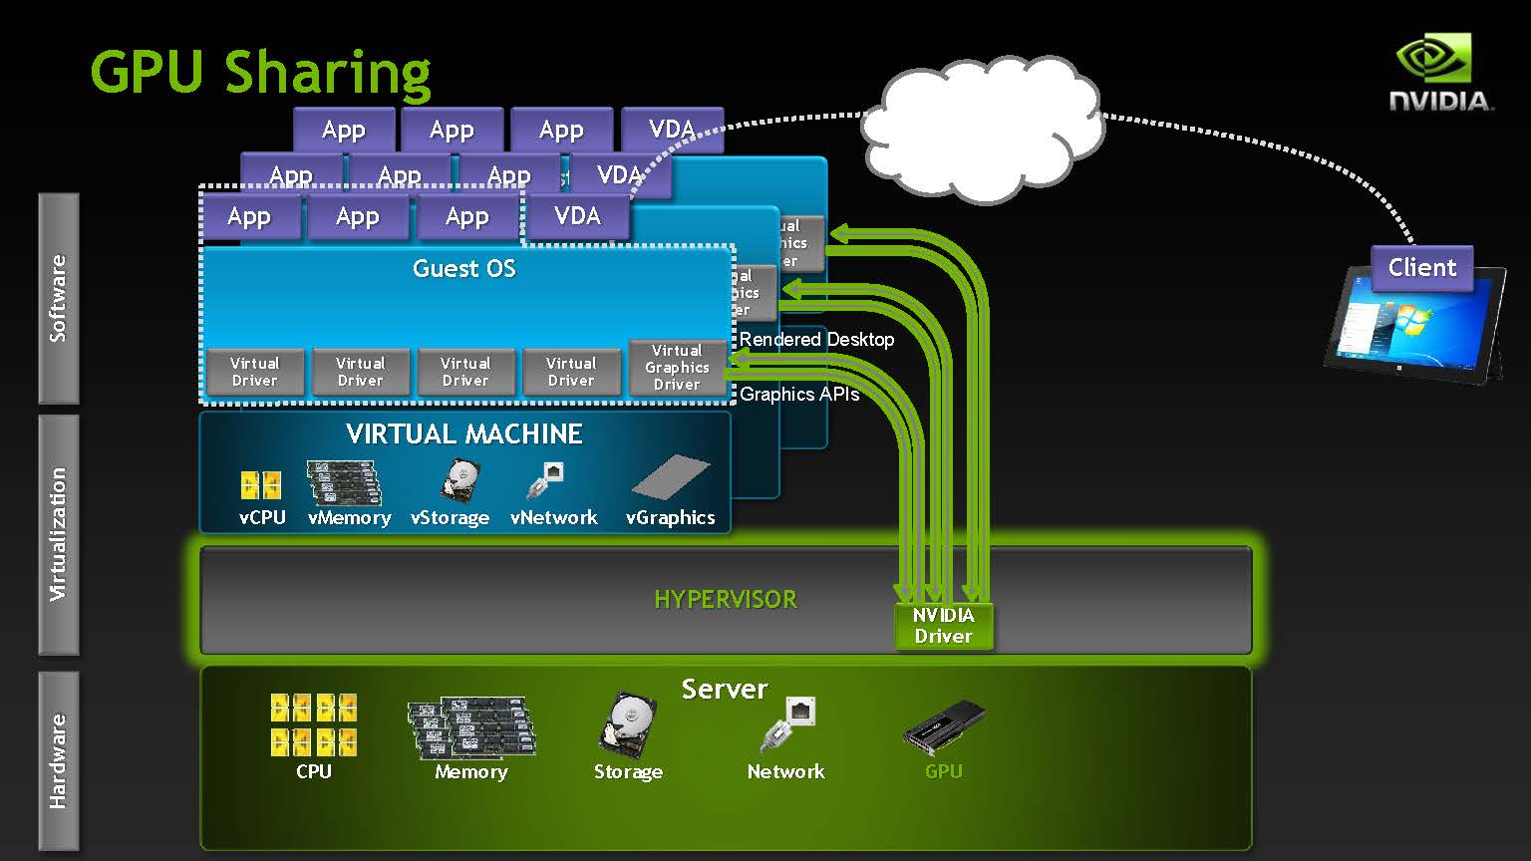
Desktop Virtualization Methods

Slide 70
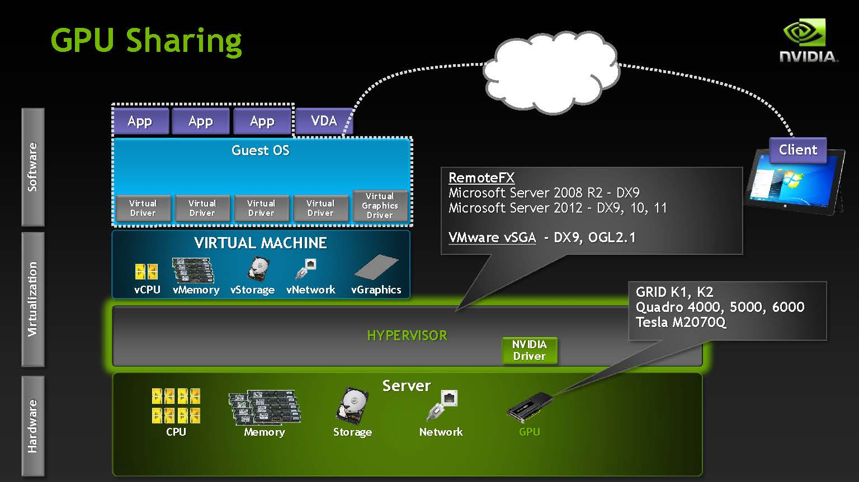
Desktop Virtualization Methods

Slide 71
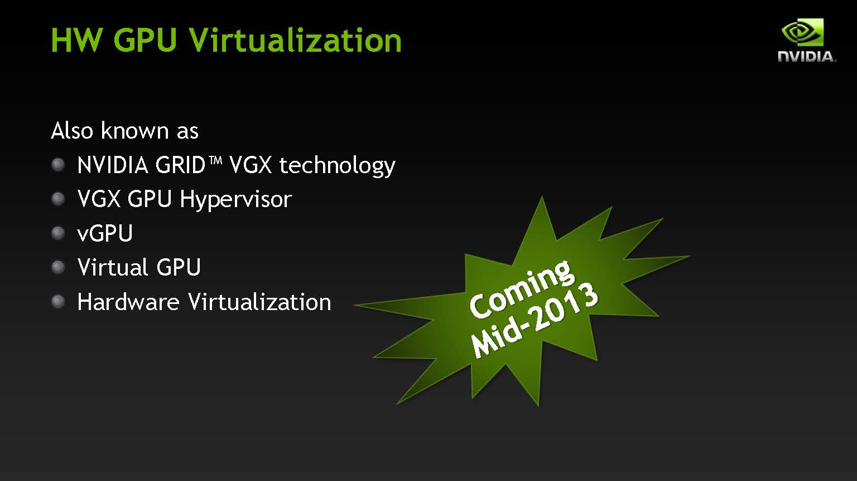
Desktop Virtualization Methods

Slide 72
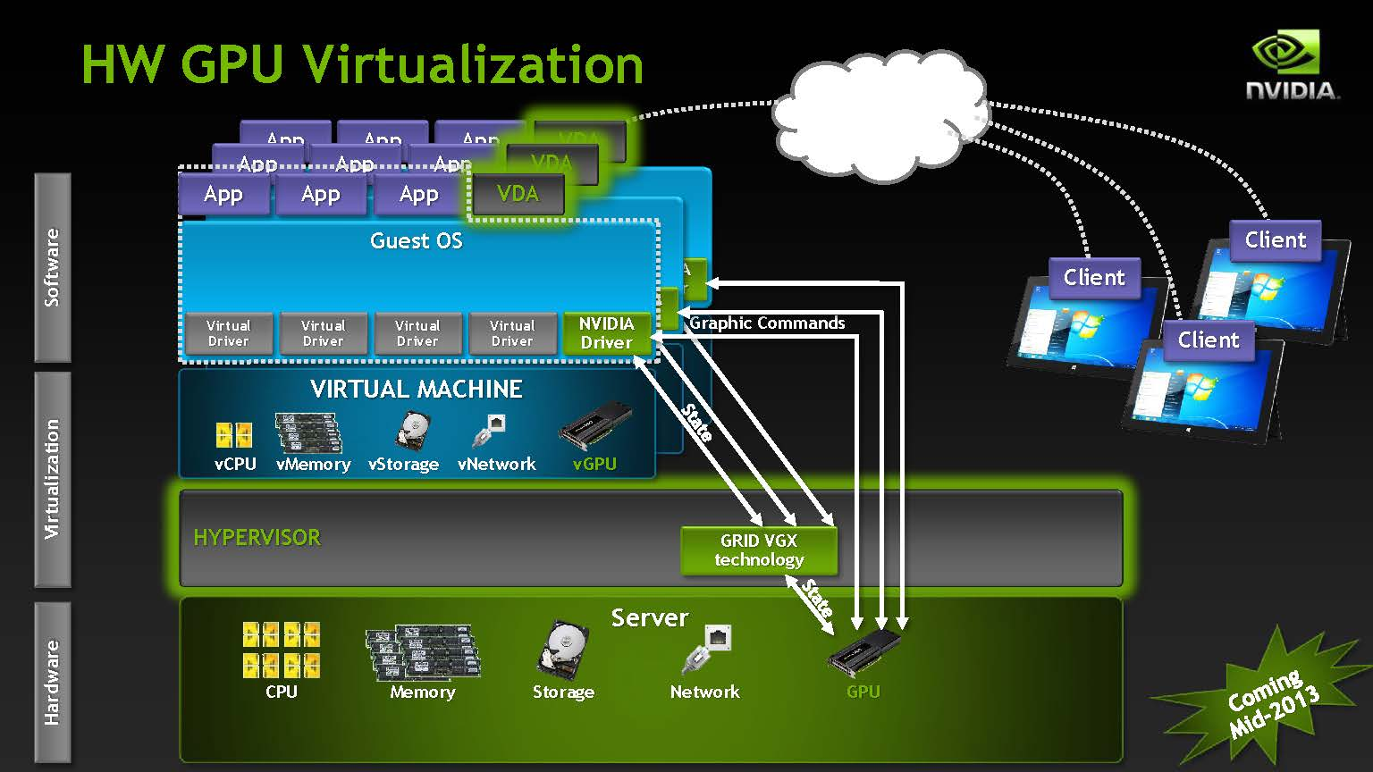
Desktop Virtualization Methods

Slide 73
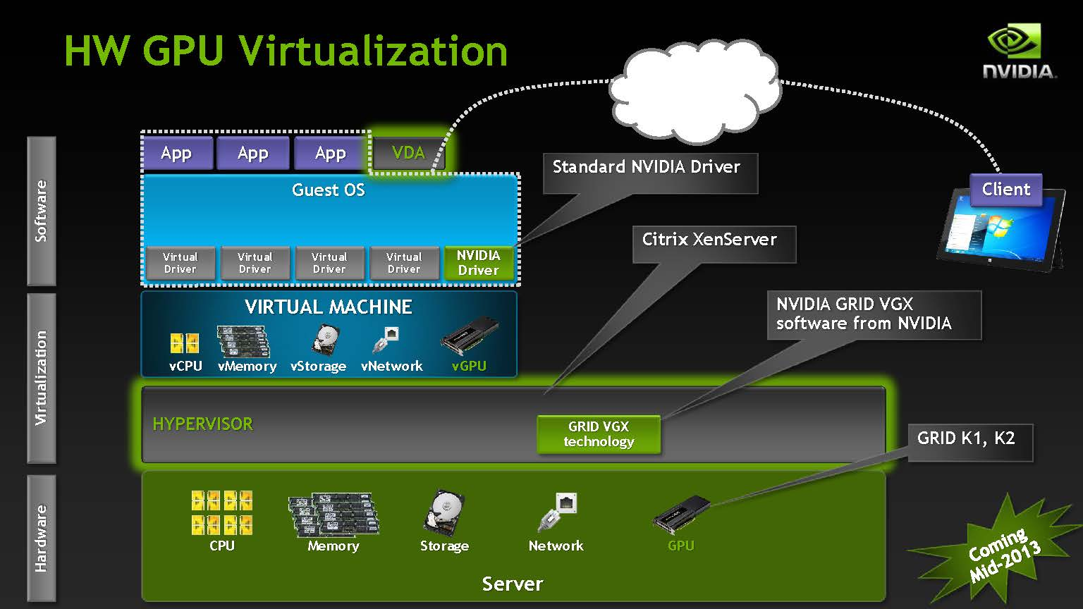
Desktop Virtualization Methods

Slide 74
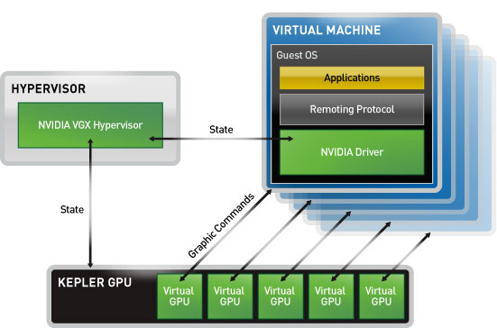
NVIDIA GRID K2
Hardware feature
2 Kepler GPUs, contains a total of 3072 cores
GRID K2 has own MMU (Memory Management Unit)
Each VM has own channel to pass through to VGX Hypervisor and GRID K2
1 GPU can support 16 VMs
Driver feature
User-Selectable Machines: depend on VM requirement, VGX Hypervisor will assign specific GPU resources to that VM
It can support remote desktop

Slide 75
NVIDIA GRID K2
Two major paths
App → Guest OS → Nvidia driver → GPU MMU → VGX Hypervisor → GPU
App → Guest OS → Nvidia driver → VM channel → GPU
The first path is similar to “Device Emulation”
Nvidia driver is front-end and VGX Hypervisor is back-end
The second path is similar to “GPU pass-through”
Part of VMs use specific GPU resources

Slide 76
References

Slide 77
References
Micah Dowty, Jeremy Sugerman, VMware, Inc. “GPU Virtualization on VMware’s Hosted I/O Architecture,” USENIX Workshop on I/O Virtualization, 2008.
J. Duato, A. J. Pe˜na, F. Silla, R. Mayo, and E. S. Quintana-Ort´ı, “rCUDA: Reducing the number of GPUbased accelerators in high performance clusters,” in Proceedings of the 2010 International Conference on High Performance Computing & Simulation, Jun. 2010, pp. 224–231.
Giunta G., R. Montella, G. Agrillo, and G. Coviello. A gpgpu transparent virtualization component for high performance computing clouds. In P. D’Ambra, M. Guarracino, and D. Talia, editors, Euro-Par 2010 - Parallel Processing, volume 6271 of Lecture Notes in Computer Science, chapter 37, pages 379–391. Springer Berlin / Heidelberg, Berlin, Heidelberg, 2010.

Slide 78
References
A. Weggerle, T. Schmitt, C. Löw, C. Himpel and P. Schulthess, “ VirtGL - a lean approach to accelerated 3D graphics virtualization,” In Cloud Computing and Virtualization, CCV ’10, 2010.
Lin Shi, Hao Chen, Jianhua Sun and Kenli Li, “ vCUDA: GPU-Accelerated High-Performance Computing in Virtual Machines ,” IEEE Transactions on Computers, June 2012, pp. 804–816.
NVIDIA Inc. “NVIDIA GRID™ GPU Acceleration for Virtualization,” GTC, 2013

